Slide 1
Getting SMART about Developing Adaptive Intervention Strategies
David M. Vock
Assistant Professor of Biostatistics
American Statistical Association Connecticut Chapter Mini-Conference

Slide 2
Outline
Why are adaptive interventions useful?
What is an adaptive intervention?
How can SMART designs help us learn about adaptive interventions and improve them?
What are some things to consider when designing a SMART trial?
Where do SMARTs fit in the personalization process?
What are some common misconceptions about adaptive interventions and SMART designs?

Slide 3
Case Studies
Program for LUng cancer screening and TObacco cessation (PI: Jospeh, co-I Vock; smoking cessation for adults undergoing low-dose CT scan)
An Adaptive Algorithm-Based Approach to Treatment for Adolescent Depression (PI: Gunlicks-Stoessel, co-I Vock; adolescent depression with IPT & meds)

Slide 4
Outline
Why are adaptive interventions useful?
What is an adaptive intervention?
How can SMART designs help us learn about adaptive interventions and improve them?
What are some things to consider when designing a SMART trial?
Where do SMARTs fit in the personalization process?
What are some common misconceptions about adaptive interventions and SMART designs?

Slide 5
Motivation for AIS
Not everyone responds to the same intervention in the same way (between person heterogeneity)
Not everyone response to an intervention is consistent over time (within person heterogeneity)
Changes in adherence, engagement, burden
Accrual of toxicity or delayed side effects
Many chronic or long-term conditions or diseases —cancer, smoking, substance use disorder, depression, obesity, ADHD, autism, or schizophrenia
BUT we may have multiple different interventions (or dosages/intensities to try)

Slide 6

How do we treat chronic disease?
Make an initial treatment decision, monitor for response/adherence, and adjusting treatment based on the individual’s changing course

Slide 7
How do we treat chronic disease?
Can we formalize this process to test different strategies improve outcomes?

Slide 8
Outline
Why are adaptive interventions useful?
What is an adaptive intervention?
How can SMART designs help us learn about adaptive interventions and improve them?
What are some things to consider when designing a SMART trial?
Where do SMARTs fit in the personalization process?
What are some common misconceptions about adaptive interventions and SMART designs?

Slide 9
Adaptive Intervention Strategy
Pre-specified sequence of decision rules
One rule for each possible decision point
Dictate what type of treatment/intervention, at what dosage/intensity, with what type of delivery (e.g., switch, augment, intensify, stay the same)
Based on measured patient characteristics (including prior response to treatment)

Slide 10
Adaptive Intervention Strategy
The intervention/treatment strategy/regime/policy is said to be “adaptive” or “dynamic” or “tailored” because it depends on a person’s evolving characteristic
Note: Stepped care intervention models are a special case of adaptive interventions

Slide 11
A Rose By Any Other Name
Adaptive Intervention Strategy (AI or AIS)
Adaptive Treatment Strategy (ATS)
Dynamic Treatment Regime (DTR)
Multistage Treatment Strategy (MTS)
Treatment Policy (TP)

Slide 12
Example AIS in Smoking Cessation
Stage 1: Initial Phase TLC (phone counseling + NRT) for 8 weeks
Stage 2: At end of 8 weeks assess 7 day abstinence
IF abstinent (complete responder) continue with TLC (at least monthly phone counseling + NRT) for 48 weeks
ELSE combine TLC with pharmacotherapy (MTM)
Complete Responder
TLC
Initial Phase TLC – 8 weeks
Incomplete Responder
TLC + MTM

Slide 13
Tailoring Variables
The variable and cutoff which determine which intervention a participant should receive are known as tailoring variables and cutpoint
Smoking cessation AIS: 7 day abstinence
Weight loss AIS: Percent change in weight
What can be a tailoring variable?
Any variable which can be measured can be a tailoring variable
This does not mean all are equally good ideas

Slide 14
Many Possible Adaptive Interventions
Typically used the following to develop AIS
Expert opinion
Clinical judgement
Piecing together an adaptive intervention using results from separate RCTs
Are these “good” adaptive interventions?
How could these adaptive interventions be improved?

Slide 15
Unanswered Questions to Optimize an AIS
Which treatment or intervention should be offered to individuals initially?
How frequently should individuals be monitored for response/nonresponse to initial treatment?
Among individuals who are not responding well to initial treatment, should their initial treatment be intensified, augmented, or switched?
Among individuals responding to treatment, what maintenance/relapse prevention treatment should be offered?

Slide 16
Outline
Why are adaptive interventions useful?
What is an adaptive intervention?
How can SMART designs help us learn about adaptive interventions and improve them?
What are some things to consider when designing a SMART trial?
Where do SMARTs fit in the personalization process?
What are some common misconceptions about adaptive interventions and SMART designs?

Slide 17
Sequential Multiple Assignment Randomized Trial
SMART Designs are type of trial design that scientists can use to optimize an AIS
Can be used to answer any of the previously posed questions

Slide 18
Sequential Multiple Assignment Randomized Trial
Multi-stage trial design - each stage corresponds to a critical decision
Participant can be randomly assigned to one of several intervention options at each stage
Set of available interventions that a single participant may be randomized to at each stage may depend on prior treatment received and/or participant characteristics
In a SMART, some or all participants are randomized at least twice; i.e., at two or more stages

Slide 19
Case Study #1: PLUTO
Several behavioral, pharmacological, and combination treatment strategies for smoking cessation
Treatments yield low rates of long-term abstinence (5-20%), and there is little evidence to help development of an AIS
Pressing need: USPSTF recommends annual lung cancer screening for those age 55 to 80 years who have a 30 or more pack year history of smoking and who are current smokers or have quit within the last 15 years

Slide 20
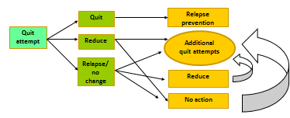
Case Study #1: PLUTO
Usual care: 8 weeks of telephone counseling + NRT
Tobacco longitudinal care: continue monthly calls for one year → recycle relapsers and reducers to make additional quit attempts
TLC algorithm for treatment non-responders

Slide 21
Case Study #1: PLUTO
TLC is an intensive intervention compared to state quit lines
Other interventions which are evidence-based which could help those who are struggling
Key questions:
For those “doing well” can we reduce the frequency of phone counseling
For those “struggling” will offering pharmacotherapy improve outcomes?

Slide 22
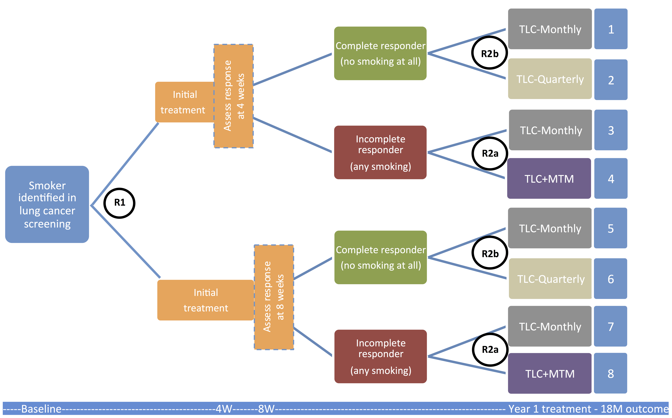
Case Study #1: PLUTO

Slide 23
Embedded Tailoring Variable/AIS
Response or nonresponse status at the end of initial-phase TLC is used to tailor the interventions that a subject may be randomized to in the second-phase
Because this tailoring variable is part of the study design → “embedded tailoring variable”
AIS which use this tailoring variable and intervention components in the study are known as “embedded adaptive intervention”

Slide 24
Embedded AIS in PLUTO
 | Phase 1 Intervention | Phase 2 Intervention for Responders | Phase 2 Intervention for Nonresponders | Cells in Figure 1 Consistent with this DTR
1 | 4 weeks of Initial Phase of TLC | TLC-Monthly | TLC-Monthly | 1 & 3
2 | 4 weeks of Initial Phase of TLC | TLC-Monthly | TLC+MTM | 1 & 4
3 | 4 weeks of Initial Phase of TLC | TLC-Quarterly | TLC-Monthly | 2 & 3
4 | 4 weeks of Initial Phase of TLC | TLC-Quarterly | TLC+MTM | 2 & 4
5 | 8 weeks of Initial Phase of TLC | TLC-Monthly | TLC-Monthly | 5 & 7
6 | 8 weeks of Initial Phase of TLC | TLC-Monthly | TLC+MTM | 5 & 8
7 | 8 weeks of Initial Phase of TLC | TLC-Quarterly | TLC-Monthly | 6 & 7
8 | 8 weeks of Initial Phase of TLC | TLC-Quarterly | TLC+MTM | 6 & 8

Slide 25
Case Study #2: Algorithms for Adolescent Depression
20% of adolescents experiencing a depressive episode at some point
Several evidence-based treatments including psychotherapy (interpersonal psychotherapy, cognitive behavioral therapy), antidepressant medication (SSRIs), and their combination.
Approximately 30-50% of adolescents who receive these treatments do not respond
Practice parameters recommend systematic and routine assessment and monitoring
Currently no guidelines to direct therapists regarding how to use those symptom assessments to guide subsequent treatment decisions

Slide 26
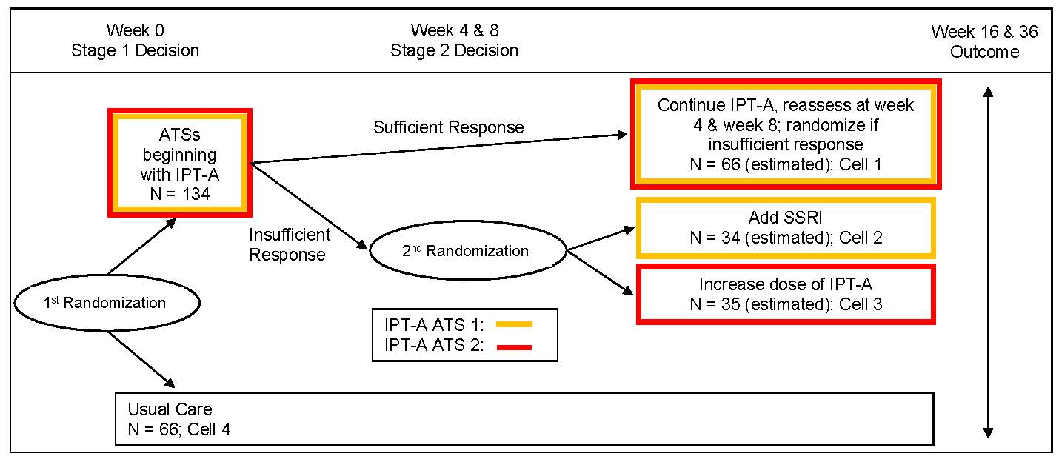
Case Study #2: Algorithms for Adolescent Depression

Slide 27
Specific Aims of PLUTO
Primary: Test whether incomplete responders to initial phase of TLC treatment benefit from the addition of MTM
Secondary: Among complete responders compare the effect of more intensive (at least monthly) follow-up to less intensive (quarterly) follow-up
Exploratory: Moderators of second-phase treatment (assessment time & # of days smoking in last week)
Exploratory: Compare different embedded adaptive interventions
Note: primary and secondary aim mirror the key questions outlined earlier

Slide 28
Stat Analysis and Power for Primary Aim
As with factorial designs, common test the main effects of intervention components
To test primary aim of PLUTO: pool data from all incomplete responders randomized to TLC (cells 3 & 7) or TLC+MTM (cells 4 & 8 and compare the outcomes using methods appropriate for the comparison of two groups
Standard formulas can be used to estimate the sample size of nonresponders needed
Overall study sample size: Dividing the sample size of nonresponders by the proportion of subjects one anticipates to be nonresponders

Slide 29
Case Study #1: PLUTO

Slide 30
Stat Analysis to Compare AIS
Want to estimate the average response to the AIS “begin with IPT-A and nonresponders receive IPT-A + SSRI”
Data from participants consistent with that embedded AIS (i.e., participants who follow the treatment paths ending in cells 1 and 2) would be used
Subjects are compliant with more than one embedded AIS. Therefore, estimators of the anticipated outcome of different embedded AISs may be correlated → robust standard errors
Responders who are consistent with an embedded AIS are over- or underrepresented relative to what we would expect if everyone in the population were to follow this regimen. Over- or underrepresentation in a sample can be corrected using a weighted analysis

Slide 31
Case Study #2: Algorithms for Adolescent Depression

Slide 32
Outline
Why are adaptive interventions useful?
What is an adaptive intervention?
How can SMART designs help us learn about adaptive interventions and improve them?
What are some things to consider when designing a SMART trial?
Where do SMARTs fit in the personalization process?
What are some common misconceptions about adaptive interventions and SMART designs?

Slide 33
Design Considerations
Old adage: “Protocolize what you know, randomize what you don’t know”
Lots to consider as part of SMART
Initial phase treatment type, intensity, and duration
Tailoring variable, cutpoint, and assessment time
Second phase treatment type, intensity, and duration for both “responders” and “nonresponders”
Cannot randomize them all and usually infeasible to randomize to more than 2-3 levels

Slide 34
Design Considerations: Selecting Treatment Types
SMARTs are about testing the sequence of interventions not establishing new ones
Frequently start with a single longitudinal evidence-based intervention and then consider ways to augment/intensify/switch
PLUTO: start with TLC and test augmenting with MTM
Adolescent depression: start with IPT-A and testing intensifying versus augmenting with SSRI
Need to consider safety and tolerability (may need pilot)

Slide 35
Design Considerations: Tailoring Variable & Cutpoint
Often second phase treatment will intensify for those with poor prognosis and focus on maintenance/relapse prevention
Tailoring variable should
Be easily measurable (in the real world)
Have good predictive value of the final outcome (e.g., C-index)
Cutpoint can be chosen to balance sensitivity and specificity

Slide 36
Design Considerations: Tailoring Variable & Cutpoint
Adolescent Depression
Tailoring variable: Hamilton Rating Scale for Depression (week 4: AUC=.78, p=.01; week 8: AUC=.81, p<.01).
At week 4 & 8, a cutoff of 20% and 40% reduction in HRSD from baseline represented the best combined sensitivity (72.7% & 72.7%) and specificity (71.4% & 83.3%)
PLUTO
Tailoring variable: 7 day abstinence
Cutpoint chosen to identify subgroup where TLC was no better than usual care

Slide 37
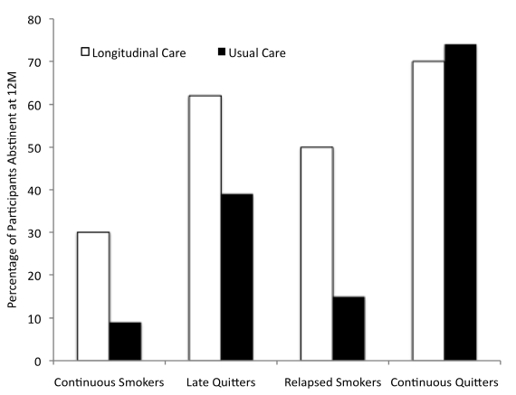
Design Considerations: Tailoring Variable & Cutpoint

Slide 38
Design Considerations: Assessment Time
Operating characteristics of tailoring variable depend on when it is measured
Need to assess nonresponse early enough to avoid discouragement but late enough to catch late relapsers
Adolescent depression: Assess response to IPT-A twice (4 and 8 weeks). Based on pilot data.
PLUTO: Randomization to 4 and 8 weeks was based on historical data

Slide 39
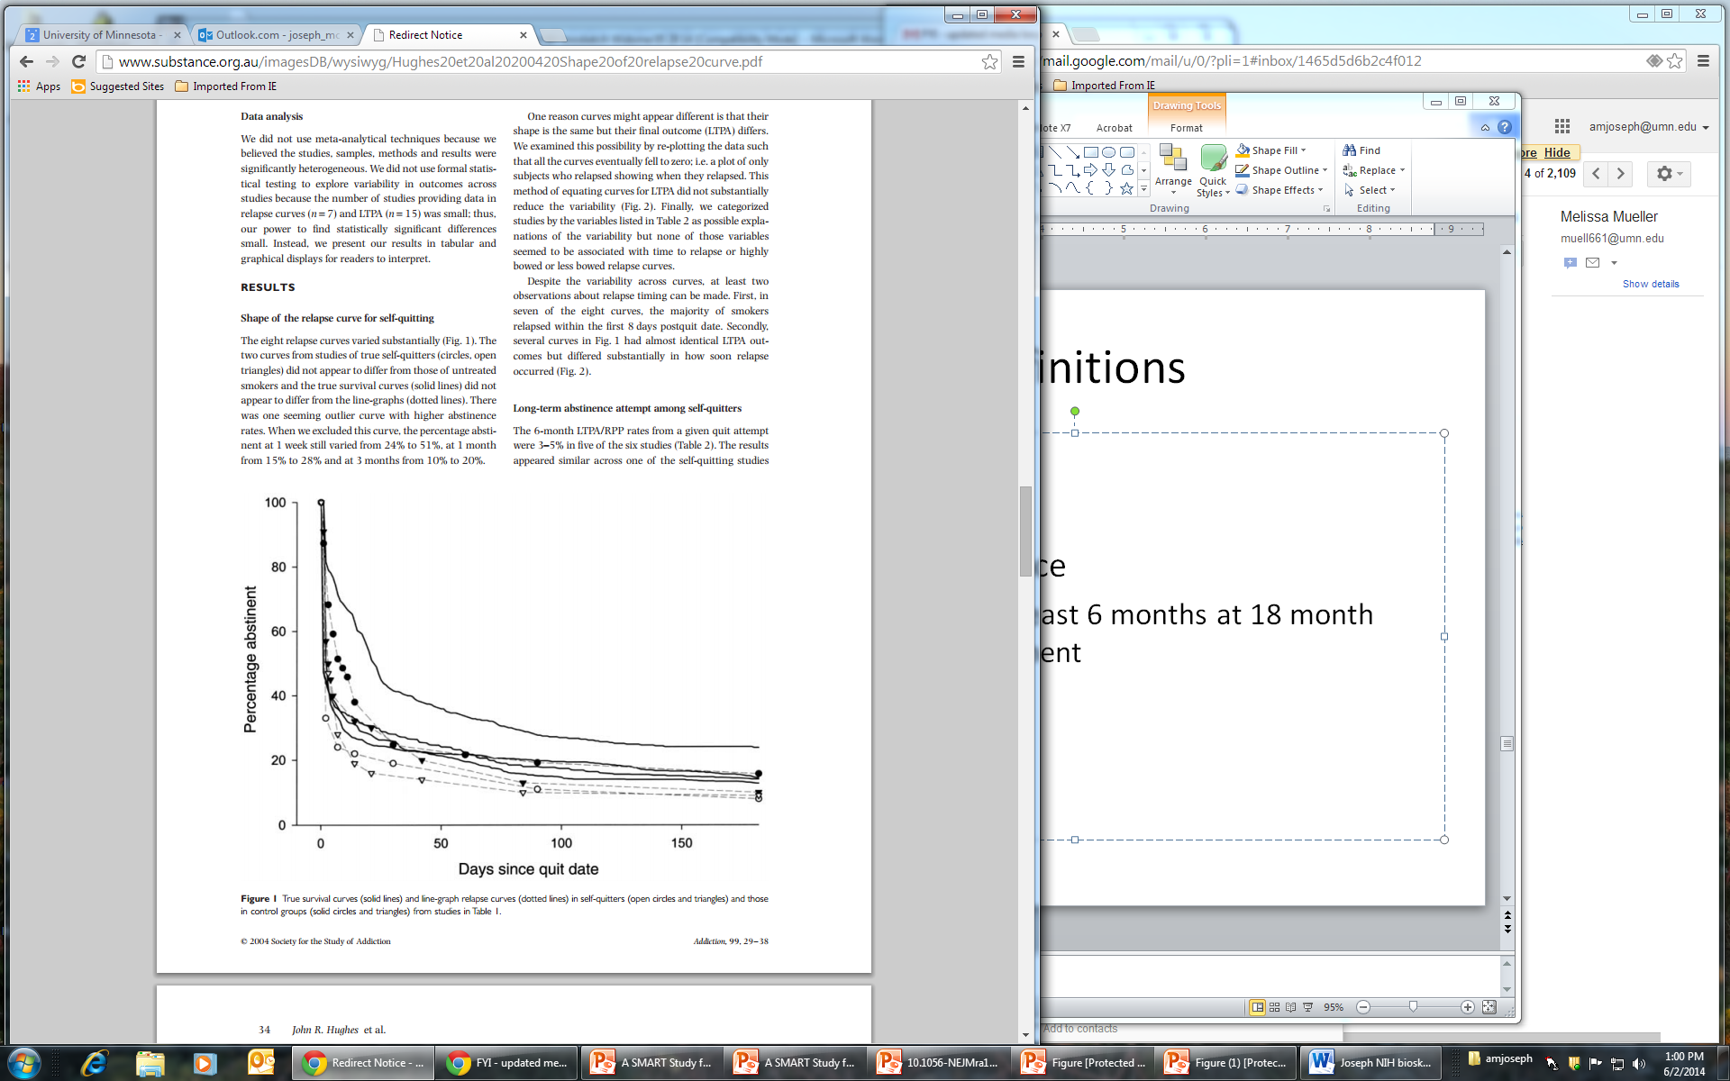
Design Considerations: Assessment Time
Sample survival curves from smoking cessation studies

Slide 40
Control Conditions Within a SMART
Many SMARTs do not include a “control” or “unpersonalized” condition → goal is to test efficacy of several AIS one of which could be carried forward
SMARTs can be designed to include a suitable control intervention
As part of the embedded AIS
As part of the initial randomization
Effect sizes will be smaller comparing two different high quality AISs than comparing AIS to usual care

Slide 41
Control AIS in PLUTO
 | Phase 1 Intervention | Phase 2 Intervention for Responders | Phase 2 Intervention for Nonresponders | Cells in Figure 1 Consistent with this DTR
1 | 4 weeks of Initial Phase of TLC | TLC-Monthly | TLC-Monthly | 1 & 3
2 | 4 weeks of Initial Phase of TLC | TLC-Monthly | TLC+MTM | 1 & 4
3 | 4 weeks of Initial Phase of TLC | TLC-Quarterly | TLC-Monthly | 2 & 3
4 | 4 weeks of Initial Phase of TLC | TLC-Quarterly | TLC+MTM | 2 & 4
5 | 8 weeks of Initial Phase of TLC | TLC-Monthly | TLC-Monthly | 5 & 7
6 | 8 weeks of Initial Phase of TLC | TLC-Monthly | TLC+MTM | 5 & 8
7 | 8 weeks of Initial Phase of TLC | TLC-Quarterly | TLC-Monthly | 6 & 7
8 | 8 weeks of Initial Phase of TLC | TLC-Quarterly | TLC+MTM | 6 & 8

Slide 42
Case Study #2: Algorithms for Adolescent Depression

Slide 43
Other Common SMART Designs
SMART with no embedded tailoring variable
C
A
R
D
R
C
B
R
D

Slide 44
Other Common SMART Designs
SMART in which re-randomization depends on a combination of first-stage treatment and nonresponse to first-stage treatment
Responder
A
A
C
Nonresponder
R
R
D
Responder
B
B
Nonresponder
R
C

Slide 45
Other Experimental Designs
Factorial Design
Multi-arm RCT
Standard RCT or series of two-arm RCTs comparing different adaptive intervention strategies
Single-stage-at-a-time experimental approach (e.g., nonresponder trial, discontinuation trial, etc.)

Slide 46
Other Experimental Designs: Drawbacks
Factorial Design – Does not allow embedded tailoring variables
Multi-arm RCT – Requires larger sample size
Standard RCT or series of two-arm RCTs comparing different adaptive intervention strategies – Requires MUCH larger sample size
Single-stage-at-a-time experimental approach (e.g., nonresponder trial, discontinuation trial, etc.) – 1) interventions may have delayed effects or interact with later-stage treatments 2) the types of nonresponding subjects who agree to participant in a trial testing two second-stage treatments may differ from the population of nonresponders

Slide 47
Outline
Why are adaptive interventions useful?
What is an adaptive intervention?
How can SMART designs help us learn about adaptive interventions and improve them?
What are some things to consider when designing a SMART trial?
Where do SMARTs fit in the personalization process?
What are some common misconceptions about adaptive interventions and SMART designs?

Slide 48
Personalization Process and Next Steps
Drug development and approval does not happen as the result of a single randomized experiment → Neither should a personalized intervention algorithm
Need to think of personalized intervention development in terms of phases analogous to drug development

Slide 49
Phase I: Pilot SMARTs
Are participants willing to have intervention re-randomized? Is personalization tolerable?
Will participants satisfactorily adhere to the proposed interventions?
Can we precisely measure any tailoring variables? How do we handle participants who don’t have tailoring variable measured?

Slide 50
Phase II: SMART Designs
Test some amount of personalization (SMART design) possibly with no “unpersonalized” control
Establish that the personalized interventions have some amount of efficacy
Design trial to allow for refinement of personalization
Use the data collected to refine personalized algorithms
(Possibly) Conduct a second phase II SMART which incorporates these refinements

Slide 51
More Deeply Tailored Interventions
Example: “Start with initial phase TLC and assess response status at 4 weeks. If a responder, continue with TLC-Q; else if a nonresponder who has smoked on two or fewer days in the past week continue with TLC-M; else continue with TLC+MTM.”

Slide 52
More Deeply Tailored Interventions
How do we find more deeply tailored interventions which improve outcomes?
Short answer: moderators, effect modifiers, interaction which are qualitative in nature
Long answer: reinforcement learning/machine learning techniques which account for delayed effects - Q-learning, A-learning, C-learning, and outcome weighted learning

Slide 53
Interaction Types

Slide 54
Next SMART
Suppose that we learn the best embedded adaptive intervention strategy is “Start with initial phase TLC. Assess smoking status at 4 weeks. If the person is a complete responder do TLC-Q, otherwise TLC+MTM”
Could compare this to a more refined adaptive strategy: For example: “Start with initial phase TLC. If the person is a complete responder at 4 weeks defer intervention decision to 8 weeks. If the person is still a complete responder at 8 weeks and QSU-B < 5 do TLC-Q, otherwise TLC-M . If the person is an incomplete responder and number of days smoking in last week > 2 do TLC+MTM, otherwise TLC-M”

Slide 55
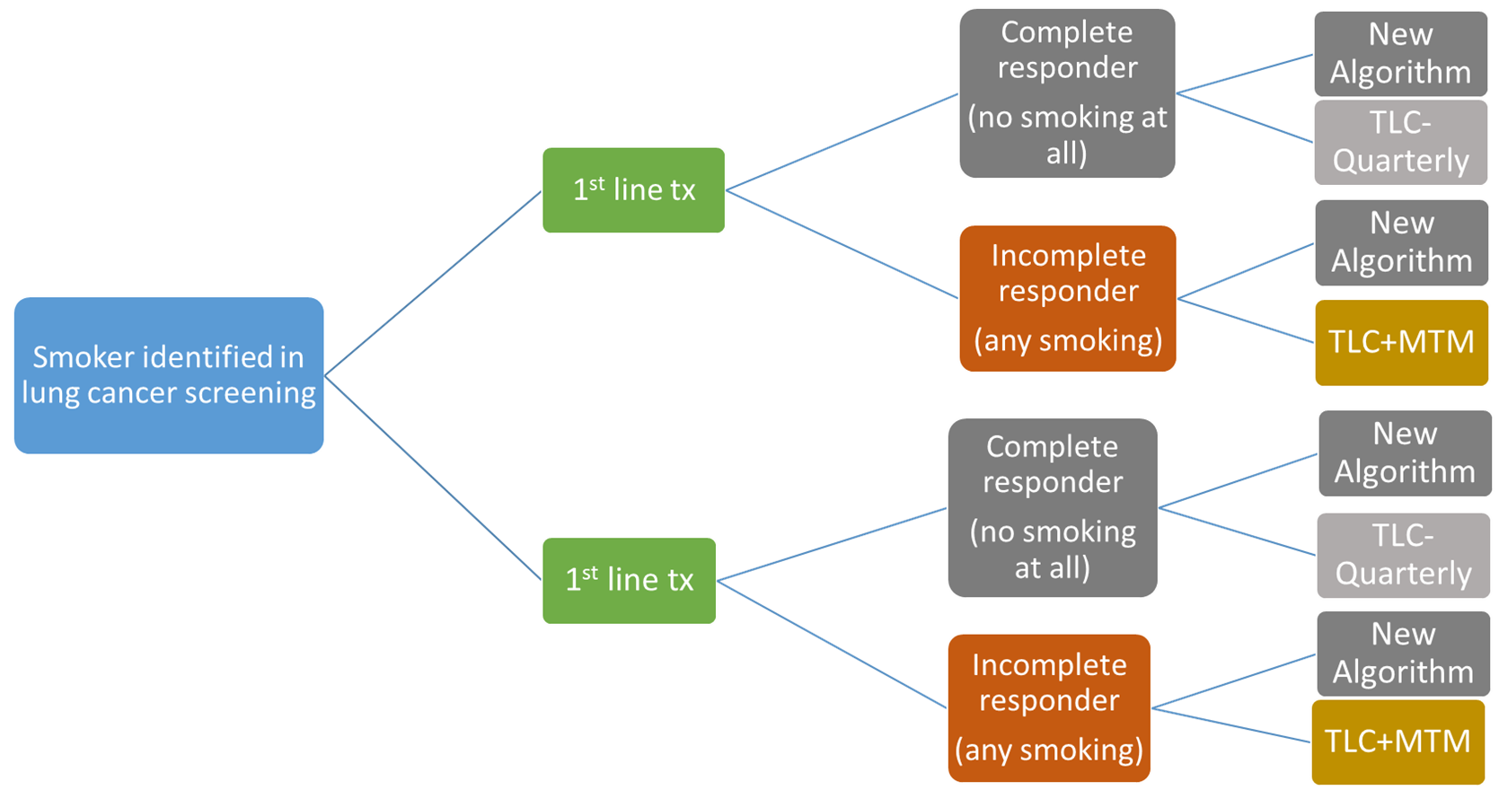

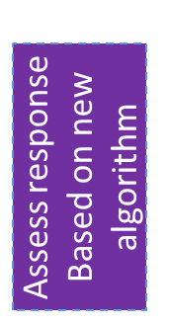
2nd SMART Design for Tobacco Cessation

Slide 56
Phase III: Confirmatory Trial
Compare more fully refined personalized algorithm against “unpersonalized” control

Slide 57
Outline
Why are adaptive interventions useful?
What is an adaptive intervention?
How can SMART designs help us learn about adaptive interventions and improve them?
What are some things to consider when designing a SMART trial?
Where do SMARTs fit in the personalization process?
What are some common misconceptions about adaptive interventions and SMART designs?

Slide 58
Common Misconceptions of AIS
Tailoring variables cannot differ based on previous intervention
An adaptive intervention must recommend a single intervention component at each decision point
Adaptive interventions seek to replace clinical judgement
Adaptive interventions are only relevant in treatment settings
Adaptive interventions are non-standard because they involve randomization

Slide 59
Common Misconceptions of SMART
SMARTs require prohibitively large sample sizes
All SMARTs require Multiple-Comparisons Adjustments
All research on adaptive interventions requires a SMART
All SMARTs must include an embedded tailoring variable
All aspects of an embedded adaptive intervention must be randomized
SMARTs are a form of adaptive research design
SMARTs never include a control group
SMARTs require multiple consents
SMARTs are susceptible to high levels of study drop-out

Slide 60
Summary
Defined Adaptive Interventions and discussed why they are important
Demonstrated that SMART study designs can be used to develop and improve adaptive intervention as part of a personalization process
Highlighted 3 SMARTs in the field

Slide 61
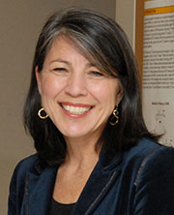


Collaborators
Anne Joseph, MD MPH
Dept of Medicine
University of Minnesota
Meredith Gunlicks-Stoessel, PHD, LP
Dept of Psychiatry
University of Minnesota
Daniel Almirall, PhD
Institute for Social Research
University of Michigan

Slide 62



Thank you!
Funding for some of the SMARTs Presented
NCI R01CA196873 (PI: Joseph, co-I Vock)
NIMH R01MH113748 (PI: Gunlicks-Stoessel, co-I Vock)
Funding for Methods Development
NCI R01CA225190 (PI: Vock)
vock@umn.edu
@docvock
directory.sph.umn.edu/bio/sph-a-z/david-vock

